Slide 1
ปกรณ์ ศิลปประภา
632110345

Slide 2
ข้อ B.

Slide 3
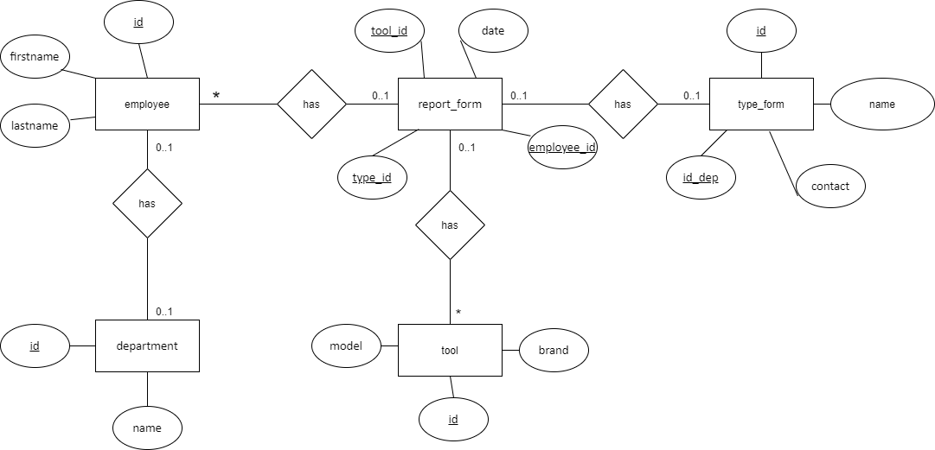
ER

Slide 4
Employee
PK | id
FK | id_dep
 | firstname lastname
No. | Name | Description | Type | Length | Extra
1 | id | This attribute is the id of employee | Integer | - | PK
2 | id_dep | This attribute is the id of department the employee works at | Integer | - | FK
3 | firstname | This attribute is the name of employee | varchar | 30 | -
4 | lastname | This attribute is the Lastname of employee | varchar | 30 | -
Department
PK | id
 | firstname lastname
No. | Name | Description | Type | Length | Extra
1 | id | This attribute is the id of department | Integer | - | PK
2 | name | This attribute is the name of department | varchar | 30 | -

Slide 5
tool
PK | id
 | brand model
No. | Name | Description | Type | Length | Extra
1 | id | This attribute is the id of tool | Integer | - | PK
2 | brand | This attribute is the brand of tool | varchar | 30 | -
3 | model | This attribute is the model of tool | varchar | 30 | -
Type_from
PK | id
FK | id_dep
 | name contact
No. | Name | Description | Type | Length | Extra
1 | id | This attribute is the id of type is from | Integer | - | PK
2 | id_dep | This attribute is the id of department the employee works at | Integer | - | FK
3 | name | This attribute is the name of from | varchar | 30 | -
4 | contact | This attribute is the contact with employee | varchar | 30 | -

Slide 6
Report_from
FK | type_id
FK | employee_id
FK | tool_id
 | date
No. | Name | Description | Type | Length | Extra
1 | type_id | This attribute is the id of type is from | Integer | - | FK
2 | employee_id | This attribute is the id of employee | Integer | - | FK
3 | tool_id | This attribute is the id of tool | Integer | - | FK
4 | date | This attribute is the check-in and check-out of employee | date | - | -

Slide 7
no | firstname | lastname | department | Check-in | Check-out | Tool_id | model | brand | Type_id | date | firstname | department
1 | mark | well | 099 | 10:10 | 23:59 | 100 | Ak-47 | Apple | 001 | 26-8-2564 | NuMaiRu | 099
2 | Rimuru | Temp | 099 | 8:00 | 20:00 | 200 | MK-18 | Realme | 001 | 26-8-2564 | NuMaiRu | 099
3 | Oker | Type-C | 099 | 10:10 | 20:00 | 200 | MK-18 | Realme | 001 | 26-8-2564 | NuMaiRu | 099
4 | jonh | baidu | 299 | 16:00 | 11:00 | 400 | G-18 | Sumsung | 001 | 26-8-2564 | NuMaiRu | 099
5 | Paw | Derbig | 399 | 8:00 | 20:00 | 300 | M-2000 | Lenovo | 002 | 26-8-2564 | NuMaiRu | 099
6 | cat | dog | 799 | 10:10 | 23:59 | 500 | Kar-98k | Razor | 001 | 26-8-2564 | NuMaiRu | 099

Slide 8
Employee
id | firstname | lastname | id_dep
001 | mark | well | 099
002 | Rimuru | Temp | 099
003 | Oker | Type-C | 099
004 | jonh | baidu | 299
005 | Paw | Derbig | 399
006 | cat | dog | 799
007 | NuMaiRu | Yoru | 099

Slide 9
tool
id | name | model
100 | Ak-47 | Apple
200 | MK-18 | Realme
300 | M-2000 | Lenovo
400 | G-18 | Sumsung
500 | Kar-98k | Razor

Slide 10
Department
id | name
099 | A
299 | B
399 | C
799 | D

Slide 11
Type_from
id | name | contact | id_dep
001 | Main | mark | 099
002 | Temporary | Rimuru | 099

Slide 12
Report_from
Type id | employee_id | Tool_id | date | Check-in | Check-out | employee_id
001 | 001 | 100 | 26-8-2564 | 10:10 | 23:59 | 007
002 | 005 | 300 | 26-8-2564 | 8:00 | 20:00 | 007
001 | 002 | 200 | 26-8-2564 | 10:10 | 20:00 | 007
001 | 003 | 200 | 26-8-2564 | 16:00 | 11:00 | 007
001 | 004 | 400 | 26-8-2564 | 8:00 | 20:00 | 007
001 | 006 | 500 | 26-8-2564 | 10:10 | 23:59 | 077

Slide 13
ข้อ C.

Slide 14
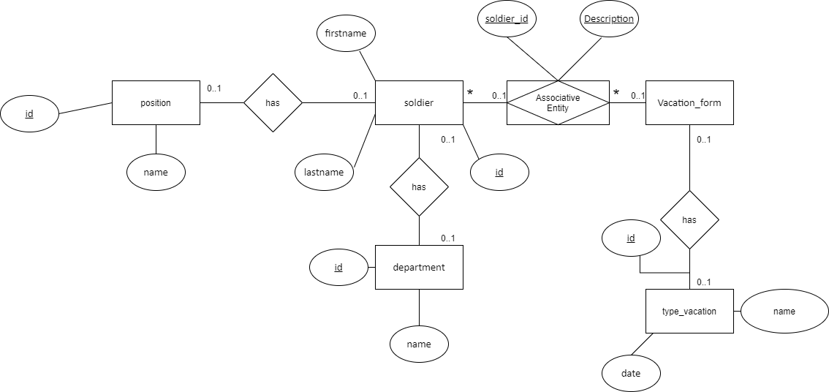
ER

Slide 15
no | firstname | lastname | department | position | Vacation_past | Vacation_having | Vacation_sum | Take leave date start | Take leave date end | Take leave date sum | Description
1 | mark | well | Cut the grass | cavalry | 10 | 4 | 14 | 26-8-2564 | 6-9-2564 | 26-8-2564 | Test01
2 | Rimuru | Temp | Sweep the floor | lieutenant | 99 | 12 | 111 | 24-8-2564 | 26-8-2564 | 26-8-2564 | Test02
3 | Oker | Type-C | Wash the car | soldier | 5 | 4 | 9 | 26-8-2564 | 6-9-2564 | 26-8-2564 | Test03
4 | jonh | baidu | Wash the car | soldier | 6 | 4 | 10 | 26-8-2564 | 6-9-2564 | 26-8-2564 | Test04
5 | Paw | Derbig | Wash the car | soldier | 7 | 4 | 11 | 26-8-2564 | 6-9-2564 | 26-8-2564 | Test05
6 | cat | dog | Wash the car | soldier | 8 | 4 | 12 | 26-8-2564 | 6-9-2564 | 26-8-2564 | Test06

